Slide 1
ARDL healthcare ethics seminar
7 June 2021
Mark Swindells
Assistant Director, Standards and Ethics

Slide 2
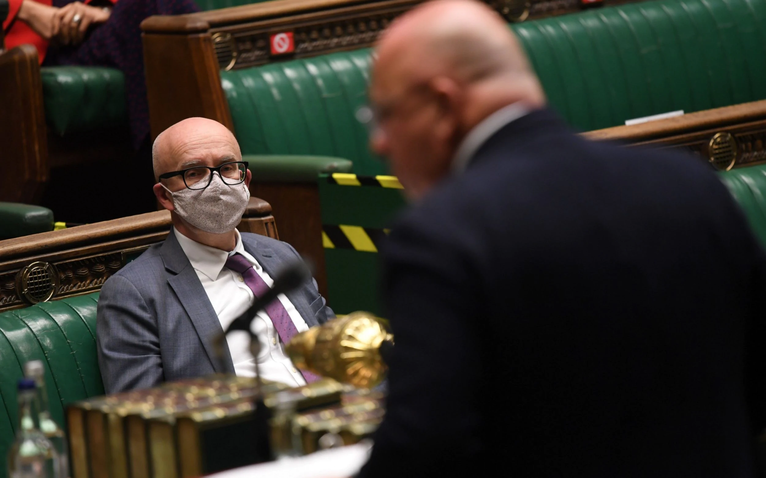
Regulatory reform
Good Medical Practice review
Professional duties & boundaries – with insights from research with members of the public

Slide 3
Regulatory reform – DHSC S60 consultation
Bringing PAs and AAs into GMC regulation
Ensuring FtP cases are Fast, Few and Fair
much greater use of consensual disposal in the FtP process
discretion to investigate rather than a duty
removing the ‘five year rule’
More flexibility on intl registration, particularly for specialists and GPs
No change proposed to statutory power for GMC to provide advice
Notes:
Currently outdated and prescriptive legislation
More flexibility for regulators to set their own policy and operations
Greater consistency across regulators through a common legislative framework
Balance - increased autonomy of regulators with greater accountability
More effective regulation allowing us to save money and do more to support both doctors and patients
To bring MAPs into regulation with the GMC
includes giving case examiners the ability to use the full suite of regulatory sanctions available to an FtP Panel, including the ability (with agreement of registrant) to suspend and erase (described as removal orders).
A section 60 order containing:
MAPs
Fitness to practise
Governance and operations
International registration
Registration and revalidation
Education and training

Slide 4
Reform should benefit many stakeholders
Patients and the public
Swifter outcomes
Less adversarial
Consistency across regulators
Employers and providers
Reduces burdens on employers to provide info
Aims to reduce duplication between local and national investigations
Registrants
Streamlined regulation process
Equal opportunity for UK and overseas professionals
More support for med students/doctors in training
Healthcare systems
More robust system for protecting the public
More flexible framework
Better consistency across regulators
Notes:
Suggest we use the material from our narrative:
For patients and the public
The proposals mean that concerns raised about a health professional’s practice could be addressed through a process called ‘accepted outcomes’. This is where a registrant is invited by the regulator to accept that both their practice is impaired, and the measure that the regulator has proposed is necessary to protect the public. It allows us to conclude a case more swiftly, and without the need for a panel hearing which is stressful for patients and registrants alike. It would also allow us to put a greater proportion of our effort and resources into driving improvements across the health system, supporting the medical profession and anticipating risks to avoid patient harm in the first place. Accepted outcome decisions will be published on our website to ensure transparency for the public (paragraphs 308-315).
The consultation proposes a new review process that will give patients and the public the right to ask for a review of a decision to close a fitness to practise case, following either an initial assessment or a decision by a case examiner (paragraphs 354-364).
The proposals mean that regulators should be able, following public consultation, to make legally binding rules covering how their processes work. This will make it easier for regulators to meet changing needs and the expectations of stakeholders (paragraph 45 and 59). Additionally, the consultation proposes the removal of the ‘five year rule’. A rule which restricts our ability to consider complaints about matters that are more than five years old unless certain criteria are met (paragraph 293).
This increased flexibility will be balanced by strengthened accountability. One of the ways this will be achieved is through a new duty of transparency for regulators (paragraph 59). This will affect how we consult on proposed changes to our processes and guidance (paragraph 59), the public visibility of our work (paragraphs 57-59) and the way we must report on our work to the UK Parliament and each of the devolved administrations (paragraphs 90-91).
The consultation proposes a common fitness to practise framework for all regulators, making it easier for patients to understand and navigate the process, particularly where their concern involves care provided by more than one profession (paragraphs 237-238).
Greater consistency will also be seen in the registers published by each of the regulators. Each regulator will hold a single register which must include, for each profession, a common minimum set of information (paragraphs 150-158).

Slide 5
GMP - Where does it fit in?
The Medical Act 1983
(1A)The over-arching objective of the General Council in exercising their functions is the protection of the public.
(1B)The pursuit by the General Council of their over-arching objective involves the pursuit of the following objectives—
(a)to protect, promote and maintain the health, safety and well-being of the public,
(b)to promote and maintain public confidence in the medical profession, and
(c)to promote and maintain proper professional standards and conduct for members of that profession.

Slide 6
GMP - Where does it fit in?
35. The powers of the General Council shall include the power to provide, in such manner as the Council think fit, advice for members of the medical profession on—
(a)standards of professional conduct;
(b)standards of professional performance; or
(c)medical ethics.

Slide 7
The guidance model as a whole
Good Medical Practice (GMP)
core guidance, setting out high level principles across all areas of a doctor's practice.
Consent and Confidentiality
explain in more detail than GMP, doctors' obligations in relation to these two fundamental ethical principles.
Explanatory guidance
Applies principles in GMP, Consent and Confidentiality to particular areas or types of practice
(e.g. end of life care)
Shorter, online only publications
expand on principles (e.g. use of social media, professional boundaries, duty of candour)

Slide 8
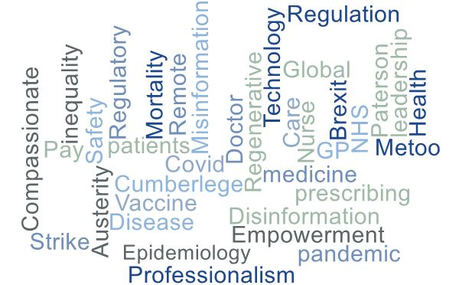
GMP – time for review
Notes:
MAPS

Slide 9
Scoping themes
The changing Environment
Post Covid-19 recovery
Technological developments
Doctors & social media-Regulation v free speech
Environmental concerns & medical waste
Electronic health records and data privacy
Vaccines
Preparing for future pandemics
changing diseases/demographics
Mis/disinformation spread on social media
Augmented humans
Internet of bodies
Patient empowerment
Reform of NHS/regulators
remote consultations

Slide 10
Scoping themes
Boundaries
Chaperones
Working with colleagues
Delegation and Referral
Leadership & Management
Sexual harassment of colleagues
Accountability
#Me Too movement
Civility
Multi Disciplinary Team working
Intimate examinations

Slide 11
Scoping themes
honesty integrity & candour
Raising and acting on concerns
Your professional career
Personal Beliefs & Medical Practice
Ending prof. r’ships with patients
Duty of candour
registrants’ wellbeing
Conflict of interest
Registrants’ working patterns
Managing risks at work
Cumberlege recommendations
Acting as a witness

Slide 12
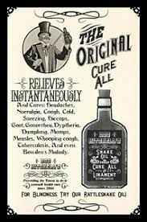
GMP – How has it evolved over time?
The Medical Act 1858 spoke of
“infamous conduct in a professional respect”
This was likely to be the 4 As …
adultery with a patient
addiction to drugs
illegal abortion
advertising services
Notes:
Page 5-7 of 1963

Slide 13
Maintaining trust
Notes:
One of four domains doctors must ensure their conduct justifies patients’ trust in them and the public’s trust in the profession. We trust doctors to use their professional judgement to apply the principles in our high level ethical guidance to the situations they face, and to be able to justify their decisions and actions. Where doctors’ behaviour is found to fall short of the standards expected of the profession, we can and do investigate to determine whether further action is required[AO] to protect patients or public confidence.
omain of our high level ethical guidance, Good Medical Practice, covers the duty of ‘Maintaining Trust’. This is clear that

Slide 14
In 2019
8654 concerns about doctors were raised with us (5677 raised by member of public)
602 were considered under provisional enquiry, enabling us to close 404 without a full investigation
1532 met our statutory threshold for investigation…
…and only five Tribunal cases related to purely issues of clinical practice.
Notes:
i.e. important

Slide 15
Conduct in a doctor’s personal life
Tribunals likely to take more serious action where certain conduct arises in a doctor’s personal life, such as:
issues relating to probity – ie being honest and trustworthy and acting with integrity
discriminating in relation to characteristics protected by law: age, disability, gender reassignment, race, marriage and civil partnership, pregnancy and maternity, religion or belief, sex and sexual orientation
inappropriate behaviour towards children or vulnerable adults
misconduct involving violence or offences of a sexual nature
drug or alcohol use disorder leading to a criminal conviction or caution
Notes:
GMC: MPTS sanctions guidance

Slide 16
What do we know of the public’s view? 1/5
Credit: Community Research Ltd
Public confidence in doctors is high worth protecting; 87% agree or strongly agree ‘the majority of doctors can be trusted to do a good job’
where doctors have committed potentially criminal acts in a non-work context, a more ‘relaxed’ view of the behaviours was more frequently expressed than if in work. As well as considering whether the doctor has harmed another person, it is expected that the GMC should base its response on whether the criminal behaviour had the potential to affect the doctor’s ability to practise safely and effectively, whether there was a pattern of criminal behaviour, or whether the behaviour suggested the doctor was dishonest, aggressive or deceitful in character.
A conviction and sentence had no more of an effect on public expectations of regulatory action than the criminal act and the circumstances surrounding it.
The most important consideration as to whether the GMC should get involved appears to be whether the doctor has (intentionally) harmed another individual
Notes:
Fluid
Commissioned by GNM review Leslie Hamilton
https://www.judiciary.uk/wp-content/uploads/2018/08/bawa-garba-v-gmc-final-judgment.pdf
The public starts with little knowledge of the GMC and its work to regulate doctors

Slide 17
What do we know of the public’s view? 2/5
Divided opinion over whether a relationship between a doctor and patient was ‘allowed’ or not, and therefore a spread of opinion regarding the expected GMC response.
Patient anecdotes on Facebook and misuse of NHS funds were clearly seen as wrong. These both called for regulatory action, but more so for misuse of funds as it implied dishonesty (not merely naivety) – a characteristic incompatible with what is expected of a doctor.
Divided opinion on the extent to which professionalism from doctors is expected outside of the workplace.
Notes:
For some patients and the public, a doctor is ‘never off duty’, and there is an expectation that the GMC will have oversight of behaviour outside of the workplace that could be regarded as unprofessional. Others feel that doctors need to be able to be off duty and that their behaviour outside of the workplace should rarely be of concern to the GMC.
primarily maintained by patients’ interactions with their doctors

Slide 18
What do we know of the public’s view? 3/5
Notes:
Scenario 2 Dr involved in fight over spilled drink in nightclub – developed by severity to which other party injured
participants were asked to consider a situation where the other person was seriously hurt in the fight, the proportion of people saying that no GMC action is expected reduced from 30% to 13% and the most frequent action (expected by 46% of the sample) is for the doctor to be given a warning.
Scenario 4 Dr K, a practising GP for 30 years, had a ‘sexual and emotional relationship’ with a patient lasting for several months. Scenario 5B Dr M made an amusing post on Facebook about how a patient had recently described their OCD behaviour and the impact it had on their life. Dr M didn’t identify the patient but when the post got shared far and wide the patient involved knew that Dr M was talking about them. Scenario 5C Dr P was us

Slide 19
What do we know of the public’s view? 4/5
Notes:
Research – no legal or gmc policy status

Slide 20
What do we know of the public’s view? 5/5
Notes:
"The GMC can’t be the love police." (Pre-family, C2DE, Newport) “That’s why I’ve struck him off because, like the teacher/pupil relationship thing, it’s a no-no.” (Empty nesters, C2DE, Belfast)
Beckwith vs SRA? Divisional Court explicitly stated in its judgment that “each regulatory scheme, for solicitors, for doctors, for barristers, and so on, must be construed and applied on its own terms. Great care must always be taken when seeking to apply an authority under one scheme to an appeal under a different scheme. Regulation of the professions is established under a series of discrete statutory codes; principles developed in one scheme may say little that informs the approach required in a different scheme.” SUMMARY
For most members of the public, there appear to be two main components for a clinical error to be considered criminal – the act, and its effect. • The act needs be intentional, deliberate or reckless. • The effect needs to be an outcome of grave and lasting harm or death. Any attempts by a doctor to cover up, falsify or blame others for clinical errors also led to the public seeing criminality

Slide 21
Discuss

Slide 22
Private Life, Social Media and FtP
7 June 2021
David Abrahams, Senior Policy Lawyer

Slide 23
The Context
Article 8 of the Human Rights Convention – Right to respect for private and family life
Everyone has the right to respect for his private and family life, his home and his correspondence.
There shall be no interference by a public authority with the exercise of this right except such as is in accordance with the law and is necessary in a democratic society in the interests of national security, public safety or the economic wellbeing of the country, for the prevention of disorder or crime, for the protection of health or morals, or for the protection of the rights and freedoms of others.

Slide 24
The Context
Article 9 of the Human Rights Convention – freedom of thought, conscience and religion
Everyone has the right to freedom of thought, conscience and religion; this right includes freedom to change his religion or belief and freedom, either alone or in community with others and in public or private, to manifest his religion or belief, in worship, teaching practice and observance.
Freedom to manifest one’s religion or beliefs shall be subject only to such limitations as are prescribed by law and are necessary in a democratic society in the interests of public safety, for the protection of public order, health or morals, or for the protection of the rights and freedoms of others.

Slide 25
The NMC’s Statutory Objectives
Article 3(4) and (4A) of the Nursing and Midwifery Order 2001
(4) The over-arching objective of the Council in exercising its functions is the protection of the public.
(4A) The pursuit by the Council of its over-arching objective involves the pursuit of the following objectives—
(a) to protect, promote and maintain the health, safety and wellbeing of the public;
(b) to promote and maintain public confidence in the professions regulated under this Order; and
(c) to promote and maintain proper professional standards and conduct for members of those professions.

Slide 26
Public Interest
Promoting and maintaining public confidence in the professions is closely related to the public interest.
A balance may need to be struck between the rights of the individual and the public interest.
The public interest - what is required to maintain public confidence - will change and develop as society changes and develops.
It may be influenced by high-profile incidents such as the Shipman case or the Mid-Staffs enquiry.
It may need to take account of the impact of social movements such as ‘Black Lives Matter’ or ‘Me Too’ on public attitudes.

Slide 27
Public Sector Equality Duty
The NMC is a public authority bound by section 149 of the Equality Act 2010.
We are required to:
have due regard to the need to… eliminate discrimination, harassment, victimisation
See the recent case of PSA v HCPC and Yong [2021] EWHC 52 for an example of this duty being applied in the context of the regulation of social workers.

Slide 28
The NMC’s Overall Approach
Published Guidance:
‘Serious concerns based on public confidence or professional standards’
We may also need to take action in cases where the concerns were not directly related to the care the nurse, midwife or nursing associate provided to people, but which call into question the basics of their professionalism. This may cover things that have happened in the nurse, midwife or nursing associate’s private life, but this will usually only happen if they’ve committed serious criminal offences.
We will take action where we consider conduct in private life calls into question the basics of professionalism.
These situations will usually (but not always) arise when someone commits a serious criminal offence.

Slide 29
Serious Criminal Offences

Slide 30
What is a serious criminal offence?
Hate crimes
Any criminal offence which is perceived by the victim or any other person, to be motivated by hostility or prejudice based on a person's race or perceived race; religion or perceived religion; sexual orientation or perceived sexual orientation; disability or perceived disability and any crime motivated by hostility or prejudice against a person who is transgender or perceived to be transgender.
Sexual offences
Any offences which involve sexual activity or sexual motivation. They also include any involvement with child pornography.
Former ‘serious arrestable offences’
For example treason, murder, manslaughter, causing death by dangerous driving and many drug-related offences.

Slide 31
What is a serious criminal offence?
The category ‘Serious arrestable offences’ also included:
Less serious offences (arrestable offences), if they led to, were intended or threatened to lead to, or were likely to lead to any of the following consequences:
serious harm to the security of the State or to public order
serious interference with the administration of justice or with the investigation of offences
the death or serious injury of any person, or a substantial financial gain or serious financial loss to any person.

Slide 32
No criminal conviction or caution?
Published Guidance
‘Investigating at the same time as other organisations’
We’d also be unlikely to investigate any alleged criminal offending that happen outside a nurse, midwife or nursing associate’s clinical practice, wasn’t related to it in any way, or had no direct link to their professional registration as a nurse, midwife or nursing associate, unless they eventually received a criminal conviction or caution.
Where an investigation of criminal conduct relating to someone’s private life (“no direct link to their professional registration”) does not lead to any criminal conviction or caution, we’re unlikely to pursue the matter further.

Slide 33
Other conduct?
Apart from criminal conduct leading to a conviction or caution, what other forms of conduct in private life could “call into question the basics of someone’s professionalism” and therefore require us to take action?
Could the use of social media ever fall into this category?

Slide 34
Our Code
20 Uphold the reputation of your profession at all times
To achieve this, you must:
20.1 keep to and uphold the standards and values set out in the Code
20.2 act with honesty and integrity at all times, treating people fairly and without discrimination, bullying or harassment
…
20.7 make sure you do not express your personal beliefs (including political, religious or moral beliefs) to people in an inappropriate way
…
20.10 use all forms of spoken, written and digital communication (including social media and networking sites) responsibly, respecting the right to privacy of others at all times

Slide 35
Our Standards
Future nurse: Standards of proficiency for registered nurses (2018)
1.4 demonstrate an understanding of, and the ability to challenge, discriminatory behaviour
…
1.14 provide and promote non-discriminatory, person-centred and sensitive care at all times, reflecting on people’s values and beliefs, diverse backgrounds, cultural characteristics, language requirements, needs and preferences, taking account of any need for adjustments
…
1.19 act as an ambassador, upholding the reputation of their profession and promoting public confidence in nursing, health and care services

Slide 36
Our Guidance on Social Media Use
Guidance on using social media responsibly
Nurses, midwives and nursing associates may put their registration at risk, and students may jeopardise their ability to join our register, if they act in any way that is unprofessional or unlawful on social media including (but not limited to):
…..
bullying, intimidating or exploiting people;
….
stealing personal information or using someone else’s identity;
encouraging violence or self-harm; and
inciting hatred or discrimination.

Slide 37
Our Guidance on Social Media Use
Guidance on using social media responsibly
Treat people with kindness, respect and compassion. (The
Code, paragraph 1.1)
Do not post anything on social media that may be viewed as discriminatory, does not recognise individual choice or does not preserve the dignity of those receiving care.
If you are unsure whether something you post online could compromise your professionalism or your reputation, you should think about what the information means for you in practice and how it affects your responsibility to keep to the Code. It is important to consider who and what you associate with on social media. For example, acknowledging someone else’s post can imply that you endorse or support their point of view. You should consider the possibility of other people mentioning you in inappropriate posts. If you have used social media for a number of years, it is important to consider, in relation to the Code, what you have posted online in the past.

Slide 38
Our Screening Guidance
Our Screening Guidance gives this example of conduct which may be suitable for local investigation:
concerns about conduct that may have been unprofessional but did not give rise to any risk of harm to the public. This could include concerns about the inappropriate use of social media.
The implication is that concerns about use of social media are less likely to require us to take action. They are more likely to be suitable for local investigation and resolution by employers.

Slide 39
Social media and seriousness
An analysis last November showed that:
15 (7%) of the 215 concerns we closed within 20 days of referral were social media concerns.
Social media concerns accounted for 13% of the concerns we closed within 20 days of referral on grounds that they did not meet our seriousness threshold.
We’re currently exploring the idea of having an ‘Enquiries Hub’ which fields enquiries including from people potentially wishing to raise a concern.
It’s still a work in progress, but the Hub would allow discussion about whether a concern (for example a social media concern) was serious enough to impair a professional’s fitness to practise.

Slide 40
Some Conclusions

Slide 41
Conclusions
Private life
We are likely to take action where someone on our register is convicted or receives a caution for a serious criminal offence, even if the offence had no connection with their professional role.
We are much less likely to take action where conduct in someone’s private life doesn’t lead to a criminal conviction or caution, but we will do so if we consider that the conduct “calls into question the basics of their professionalism”.
An example might be serious racist or homophobic abuse, even if it took place entirely outside the workplace. We would be likely to take action even if the conduct did not lead to any criminal conviction or caution.

Slide 42
Conclusions
Private life – example
Nurse M was employed at a care home. She went on annual leave to travel to Zimbabwe. Shortly afterwards she contacted her employer to say that her husband had been shot and had died and that she needed an extra two weeks’ leave to arrange his funeral. The matter was referred to the NMC when media reports indicated that Nurse M was suspected of having murdered her husband.
Nurse M was charged in Zimbabwe, successfully applied for bail, but then failed to appear in court in breach of her bail conditions. A warrant was issued for her arrest. The Non-European Union Exchange of Criminal Records Department confirmed that Nurse M was being investigated for murdering her husband in Zimbabwe and was currently “on the run”.
Nurse M was removed from our register for her failure to cooperate with the criminal investigation into her husband’s murder.

Slide 43
Conclusions
Use of Social Media
We have clear guidance about behaviour on social media that we consider unacceptable:
bullying or intimidation
encouraging violence or self-harm
inciting hatred or discrimination
We also have published guidance suggesting that concerns about social media use may be more suitable for local investigation and resolution, rather than for action by us.
As ever, everything will turn on the facts of individual cases. It’s only in the most serious social media cases that we might want to take action - especially if there is no link to professional practice. An example might be engaging in serious online bullying or intimidation.

Slide 44
Conclusions
Online messaging - example
Nurse O
Nurse O was arrested and interviewed in relation to an allegation of sexual activity by an adult with a child under 13. The allegations related to messages between Nurse O and another person describing sexual activity with children. Nurse O stated that the contents of the messages were fictitious and the children referred to did not exist. The police decided to take no further action in respect of any offence.
The NMC’s Case Examiners decided that there was a regulatory case for Nurse O to answer. The CEs noted that nurses are under a duty to uphold the reputation of the profession at all times and are also required to use all forms of spoken, written and digital communication (including social media and networking sites) responsibly. There was evidence that the Respondent was an active participant in a large number of sexually explicit conversations describing child abuse. The matter was referred to the Fitness to Practise Committee.

Slide 45
A Note of Caution
The term private life can be a slippery one.
In the recent Scottish case of BC v Chief Constable of the Police Service of Scotland 2020 [CSIH] 61, the police officers claimed that the use of their WhatsApp messages in police disciplinary proceedings was a breach of their Article 8 rights.
But the messages:
were exchanged between serving police officers
involved discussion of police operations
included the sharing of photographs taken while on duty
Given those facts, the Court’s conclusion that there was no infringement of the officers’ Article 8 rights seems unsurprising. The link between the messages and the officers’ role as police officers was clear and obvious.

Slide 46
When is private life not private?
Regulators may often face situations where the professional they are concerned about claims that the alleged conduct was part of their private life but the regulator considers that there is a clear and obvious link to their professional role.
Example – Nurse C
Nurse C was investigated for fraud. The charges arose from Nurse C’s employment. It was alleged that she accepted money between 2006 and 2015 from Patient A. She admitted that the amount received was well over £100,000.
Patient A was an elderly blind gentleman. Nurse C provided care to Patient A while he was an inpatient in 2005. After Patient A was discharged, Nurse C visited him in his home regularly from 2006 - 2017, until his son raised a complaint with the police. The police investigated the complaint but decided not to proceed to a prosecution.

Slide 47
When is private life not private?
Example – Nurse C - continued
The NMC alleged that Nurse C failed to maintain professional boundaries in relation to Patient A, who was under her care in December 2005. Nurse C developed a familial relationship between herself and Patient A. Nurse C’s actions in accepting large sums of money from Patient A demonstrated a lack of integrity. Nurse C was removed from our Register.

Slide 48
When is private life not private?
Code provisions relevant to case of Nurse C
20.5 treat people in a way that does not take advantage of their vulnerability or cause them upset or distress
20.6 stay objective and have clear professional boundaries at all times with people in your care (including those who have been in your care in the past), their families and carers
….
21.1 refuse all but the most trivial gifts, favours or hospitality as accepting them could be interpreted as an attempt to gain preferential treatment
21.2 never ask for or accept loans from anyone in your care or anyone close to them
21.3 act with honesty and integrity in any financial dealings you have with everyone you have a professional relationship with, including people in your care

Slide 49
Final Word
We are quite clear that we can take action in relation to a professional’s private conduct (including use of social media) but we are more likely to take action where there is a clear link between the conduct and the professional role.

Slide 50
www.nmc.org.uk

